Slide 1



Zero Lecture

Slide 2

Program Code: NA
Program Name: MCA
Course Name & Code: Cloud Computing [PGCA1937 ]
Lecture Zero
The Kick Start Session
Name: Dr. Gurvir Kaur
Designation: Assistant Professor

Slide 3
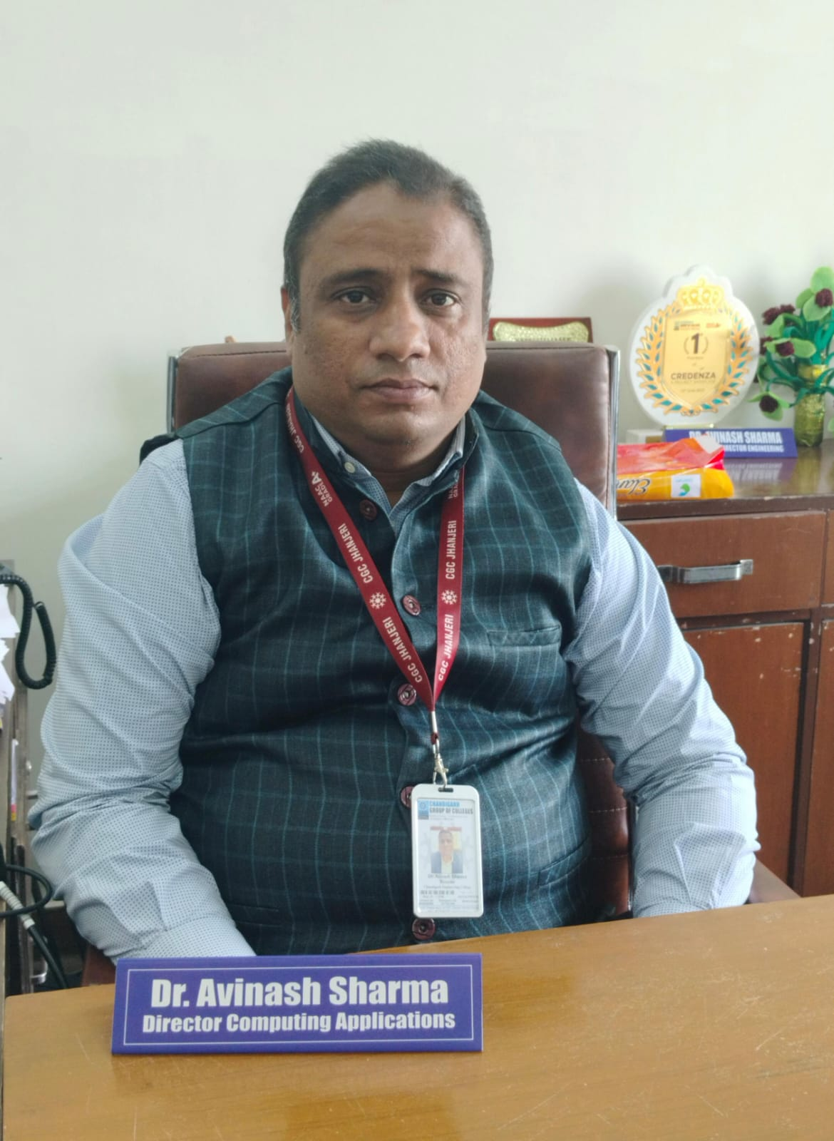
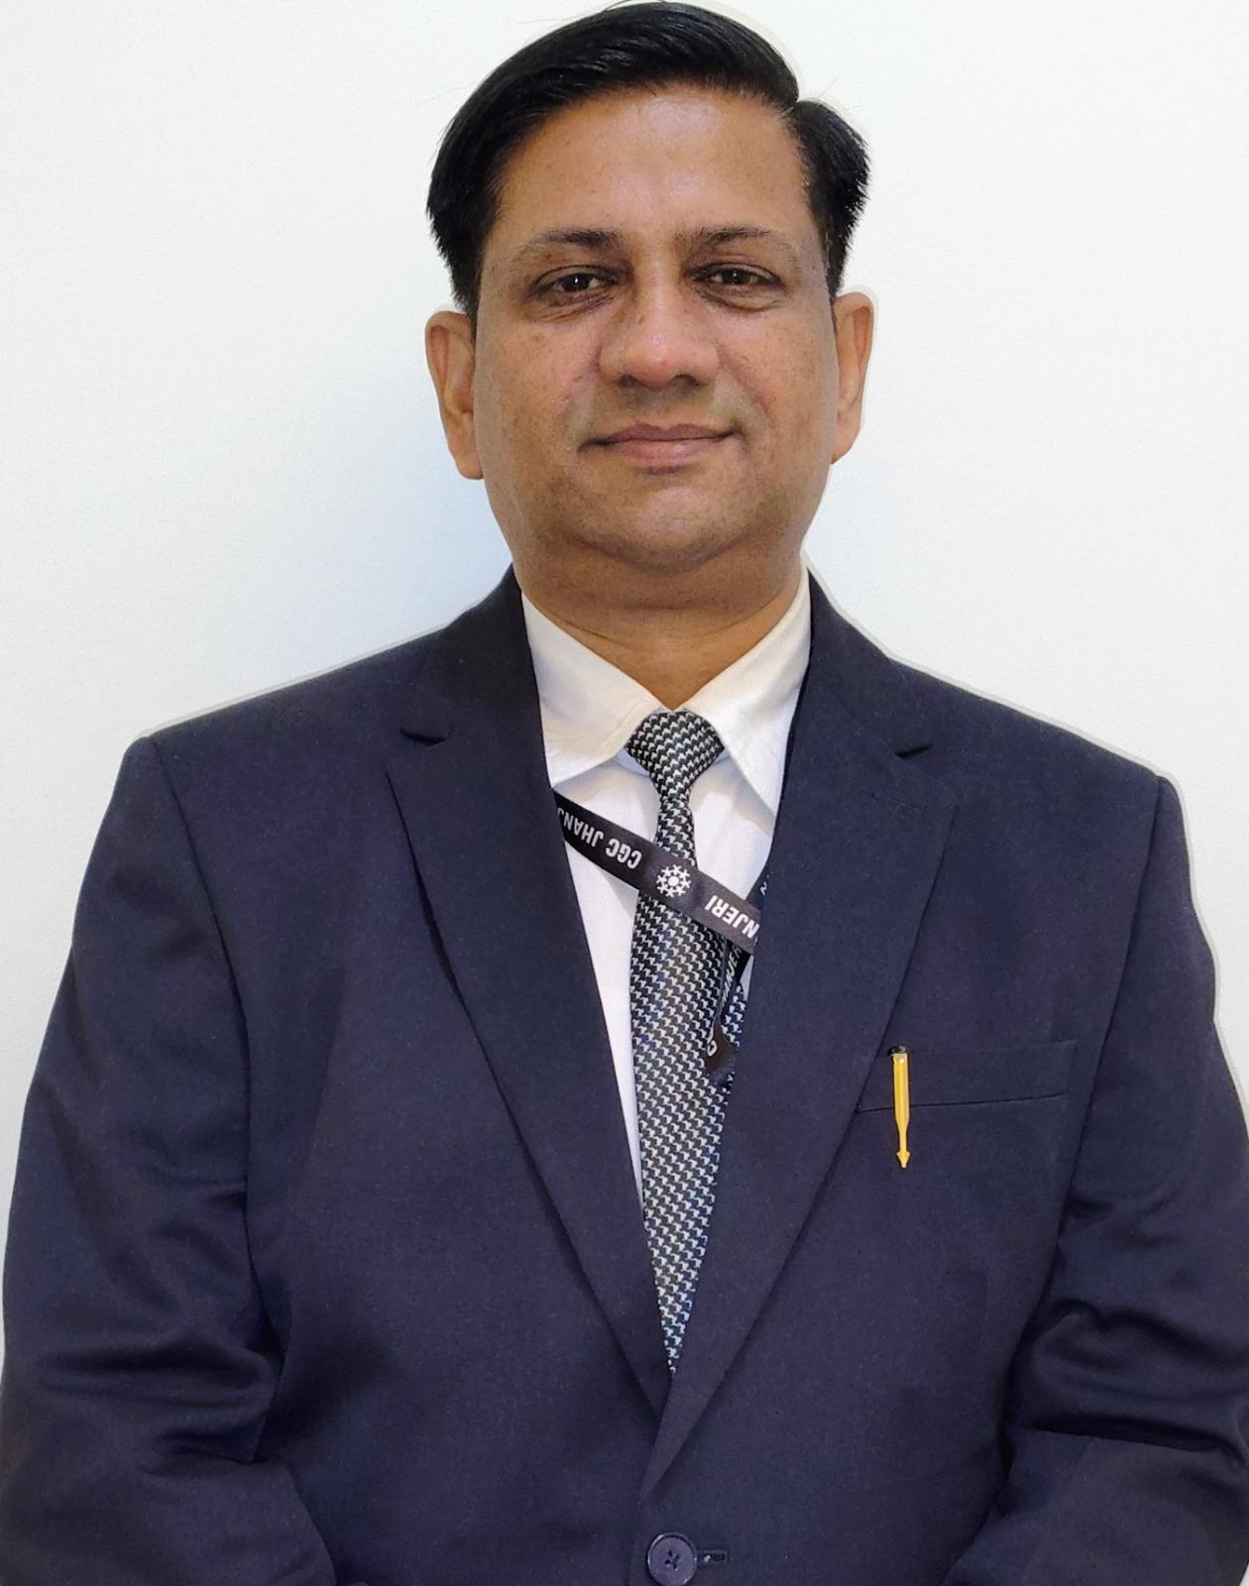
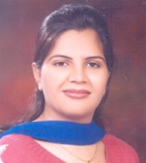
Department Overview
Dr. Avinash Sharma
Director
Dr. Amit Jain
Associate Director
Ms. Rohini Mahajan
HOD

Slide 4
Course Details
L T P-
Credits: 3
Text Book
Mastering Cloud Computing, Rajkumar Buyya, Christian Vecchiola, and ThamaraiSelvi, Tata McGraw Hill, ISBN-13: 978-1-25-902995-0, New Delhi, India,Feb 2013.
Cloud Computing Bible, Barrie Sosinsky, Wiley India Pvt. Ltd, ISBN-13: 978-81-265-2980-3,New Delhi, India, 2011.
Reference Book-
Cloud Computing For Dummies, Fern Halper, Hurwitz, Robin Bloor, Marcia Kaufman, Wiley India Pvt. Ltd, ISBN-13: 978-0-47-0597422, New Delhi, India, 2011.
4 | 0 | 0

Slide 5
Program Outcomes
p | Program Outcome (PO) | OUTCOME DESCRIPTION
1 | PO1 | Computational Knowledge: Apply knowledge of computing fundamentals, computing specialization, mathematics, and domain knowledge appropriate for the computing specialization to the abstraction and conceptualization of computing models from defined problems and requirements.
2 | PO2 | Problem Analysis: Identify, formulate, research literature, and solve complex computing problem searching substantiated conclusions using fundamental principles of mathematics, computing sciences, and relevant domain disciplines.
3 | PO3 | Design /Development of Solutions: Design and evaluate solutions for complex computing problems, and design and evaluate systems, components, or processes that meet specified needs with appropriate consideration for public health and safety, cultural, societal, and environmental considerations.
4 | PO4 | Conduct investigations of complex Computing problems: User search-based knowledge and research methods including design of experiments, analysis and interpretation of data, and synthesis of the information to provide valid conclusions.
5 | PO5 | Modern Tool Usage: Create, select, adapt and apply appropriate techniques, resources, and modern computing tools to complex computing activities, with an understanding of the limitations.
6 | PO6 | Professional Ethics: Understand and commit to professional ethics and cyber regulations, responsibilities, and norms of professional computing practices.

Slide 6
Program Outcomes
p | Program Outcome (PO) | OUTCOME DESCRIPTION
1 | PO7 | Life-long Learning: Recognize the need, and have the ability, to engage in independent learning for continual development as a computing professional.
2 | PO8 | Project management and finance: Demonstrate knowledge and understanding of the computing and management principles and apply these to one’s own work, as a member and leader in a team to manage projects and in multidisciplinary environments.
3 | PO9 | Communication Efficacy: Communicate effectively with the computing community, and with society at large, about complexcomputingactivitiesbybeingabletocomprehendandwriteeffectivereports, design documentation, make effective presentations, and give and understand clear instructions.
4 | PO10 | Societal and Environmental Concern: Understand and assess societal, environmental, health, safety, legal, and cultural issues within local and global contexts, and the consequential responsibilities relevant to professional computing practices.
5 | PO11 | Individual and Team Work: Function effectively as an individual and as a member or leader in diverse teams and in multidisciplinary environments.
6 | PO12 | Innovation and Entrepreneurship: Identify a timely opportunity and using innovation to pursue that opportunity to create value and wealth for the betterment ofthe individual and society at large.

Slide 7
Course Outcomes
CO1 Understand the basic concept and importance of cloud computing.
CO2 Access the suitability of migrating to a cloud solution for different applications.
CO3 Compare and evaluate the virtualization technologies.
CO4 Monitor and manage the cloud resources, applications and data while addressing the security concerns.
CO5 Use cloud solutions offered by industry leaders for various applications.

Slide 8
Internal Assessments
Examinations:
4 Assignments need be submitted in 3^{rd,} 6th, 9th, and 12th Week of the Semester.
Mid Term Examination
End Term Exam.

Slide 9
Assessment Model
Attendance: 06
MST: 24
Assignment: 10
ETP: 70
Total: 100

Slide 10
Assignment Schedule
 | Allotment Weeks | Submission weeks | Marks
Assignment -1 | 2nd Week | 3rd Week | 10
Assignment -2 | 5th Week | 6th Week | 10
Assignment -3 | 8th Week | 9th Week | 10
Assignment -4 | 11th Week | 12th Week | 10

Slide 11

The Hitch……
The three BURNING questions in mind…
Why are we learning Cloud Computing?
What would we do with it?
What will be the course outcome?

Slide 12
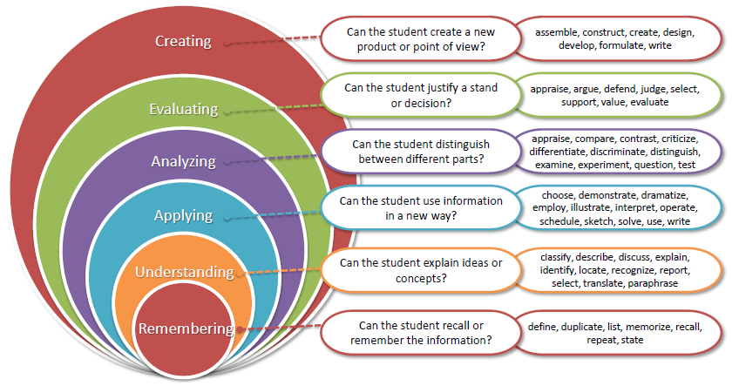
Bloom’s Taxonomy
‹#›

Slide 13

Let us re-invent ourselves
To begin with basics…
Let us go to basics.
Let us begin from toddling to learn to walk

Slide 14
Course Content
Part-A
Overview of Computing Paradigm: Recent trends in Computing -Grid Computing, Cluster Computing, Distributed Computing, Utility Computing, Cloud Computing.
Introduction to Cloud Computing: Vision of Cloud Computing, Defining a Cloud, Cloud Reference Model, Deployment Model, Characteristics, Benefits of Cloud Computing, Challenges ahead. Cloud computing vs. Cluster computing vs. Grid computing.
Migrating into a Cloud: Introduction, Broad approaches to Migrating into the Cloud, The Seven-Step Model of Migration Into a Cloud.
Virtualization: Introduction, Characteristics of Virtualized environment, Taxonomy of Virtualization techniques, Virtualization and Cloud Computing, Pros and Cons of Virtualization, Technology Examples- Xen, VMware, Microsoft Hyper-V.
Capacity Planning: Introduction, Defining Baseline and Metrics-Baseline Measurements, System Metrics, Load Testing, Resource Ceilings, Server and Instance types; Network Capacity, Scaling.

Slide 15
Course Content
Part-B
SLA Management in Cloud Computing: Inspiration, Traditional Approaches to SLO Management, Types of SLA, Life Cycle of SLA, SLA management in Cloud. Automated Policy-based management.
Securing Cloud services: Cloud Security, Securing Data- Brokered Cloud Storage Access, Storage location and tenancy, Encryption, Auditing and compliance.
Cloud Storage: Provisioning Cloud Storage, Virtual storage containers, Cloud Storage Interoperability (CDMI, OCCI), Database Storage, Resource Management,
Advance Topics in Cloud:Energy Efficiency in cloud, Market Oriented Cloud Computing, Federated Cloud Computing, Mobile Cloud Computing, Fog computing, BigData Analytics, Basics of IoT.
Cloud Platforms in Industry: Amazon Web Services-Compute Services, Storage Services, Communication Services, Additional Services. Google AppEngine-Architecture and Core Concepts, Application Life Cycle. Cost Model. Microsoft Azure-Azure Core Concepts, SQL Azure, Windows Azure Platform Appliance.

Slide 16
Lets clear some Basics….
Web technologies?
What is Cloud Computing?
What are the Benefits of Cloud Computing?
What are the Different Types of Cloud Computing Services?
What are Some Popular Cloud Providers?
How is Cloud Computing Different from Traditional IT Infrastructure?

Slide 17
MOOCs/Competitions
/Hackathons
Udemy
Coursera
EDX
Udacity

Slide 18
Summary
Course Overview
Course Objectives
Course Outcomes
Understanding the basics of Cloud Computing

Slide 19

Any Queries ?

